Slide 1
Growth of the Airline Industry
Group A7:
Erya Ma, Wendy Huang, Gloria Hu

Slide 2
Working Plan
Data Cleaning | Predicted: 4 hours
Actual: 6 hours
Data Manipulation | Predicted: 8 hours
Actual: 9 hours
Plotting & Report | Predicted: 14 hours
Actual: 20 hours

Slide 3
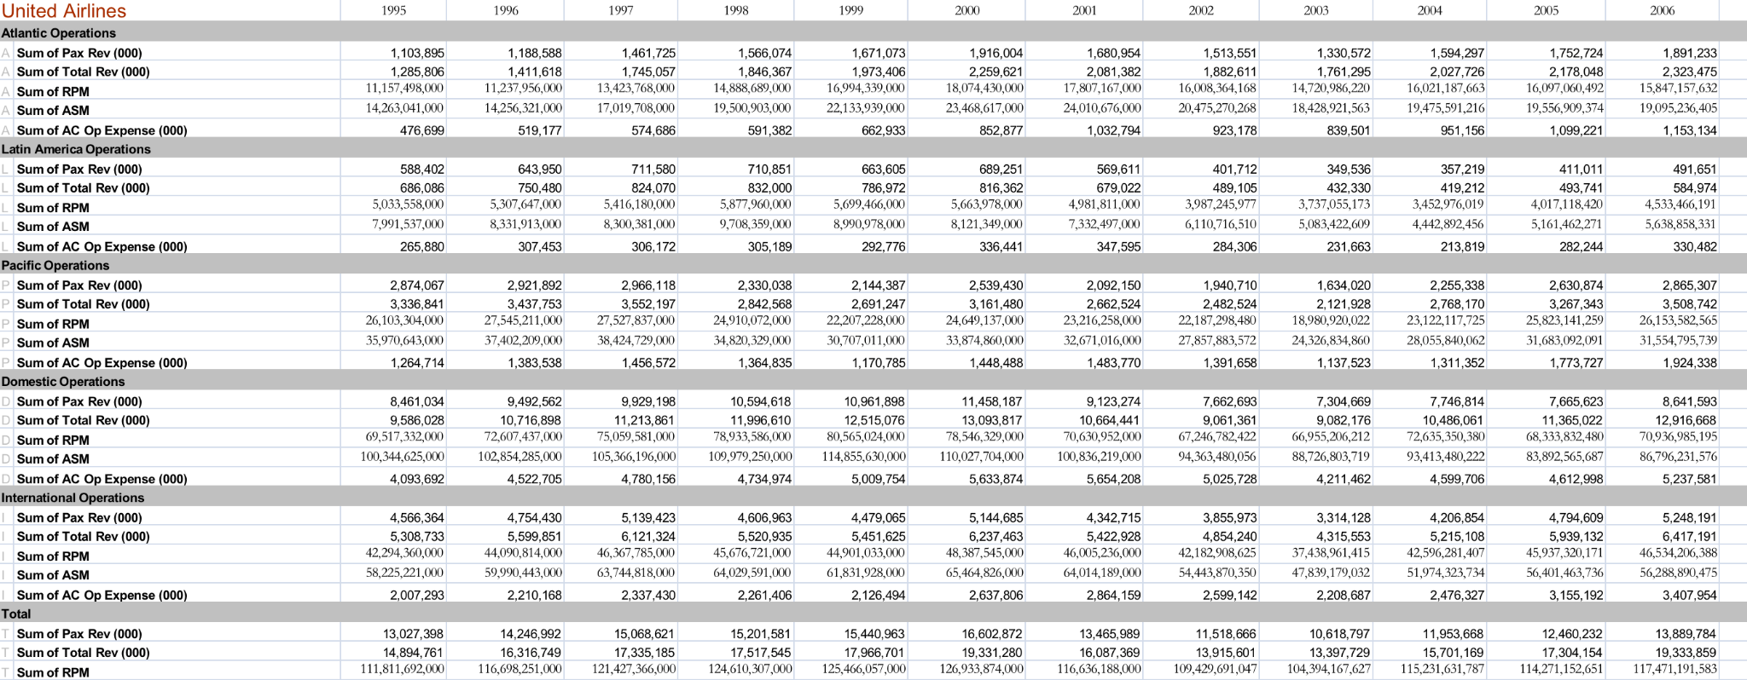

Slide 4
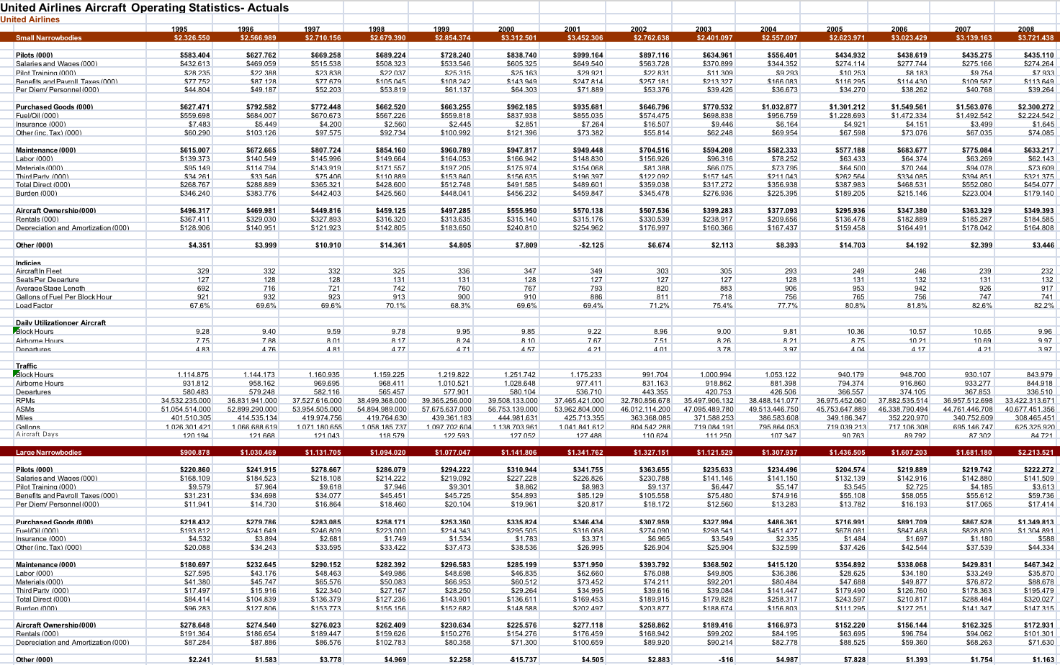

Slide 5
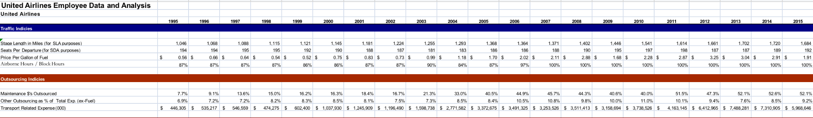
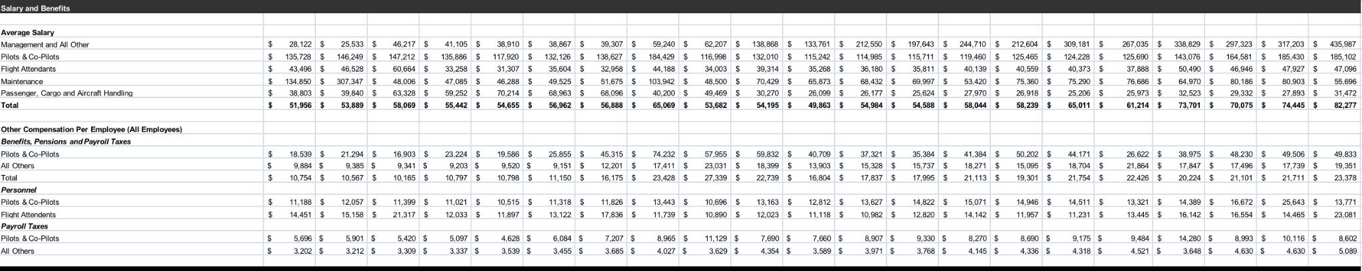

Slide 6
Motivation and background
Traveling by air becomes more common and popular
Revenue and expenses have increased dramatically
Explore the potential correlation or related association in the industry

Slide 7
Challenge Goals
We will use various methods in our project to make our data visualization insightful and clear to understand. Some of the datasets need to be sorted and re-filtered by creating new columns, converting strings to float, dropping unnecessary variables, and reorganizing the required dataset. Our plot formats are various: line chart, multiple-line diagram, histogram, dotplot, and we implement a regression line to our visualization for more significant analysis. We will use what we’ve learned to make a solid and concise data visualization to promote both input and output.
We will use multiple datasets in our project, and data is messy. We need a format that would be useful for the analysis. We need multiple datasets to come up with a richer analysis. And some questions require us to join tables together to solve. We will take time to consider which data should include in our dataframe and how to reformat it. Through collaborative effort, we can achieve our goal.

Slide 8
Research Questions
UA_operation_summary.csv
UA_aircraft_spending.csv
UA_salary_benefits.csv
$3,000
What is the trend of revenue passenger miles of each type of operation? Which year has the highest RPM? Which year has the lowest RPM? What’s the trend of overall RPM?
Which type of aircraft(small narrowbodies, large narrowbodies, and widebodies) has the highest salary for a pilot over the years? Do they have similar salary trends over years?
What’s the trend of overall UA Average salaries for each type of employee over time? Is there any correlation between the average salary s and each type of employee position? Explain what you’ve found through each diagram and point out important insights.
Jupiter is the biggest planet in the entire Solar System

Slide 9
Methodology
01
02
03
Reformat the original dataframe,
Create a new dataframe
Plot a multiple line graph using seaborn with year in axis and Sum of RPM (Revenue Passenger Mile) in y axis
Create a new dataframe
Groupby the aircrafts types, salary, and year
Plot a line graph using the Matplotlib library
Create a new dataframe with job position, salary, and year
Convert data to floats instead of string
Use the droppna method to clean the data
Plot each employee position with their average salary over time by using regression plot, dot plot, and histogram

Slide 10
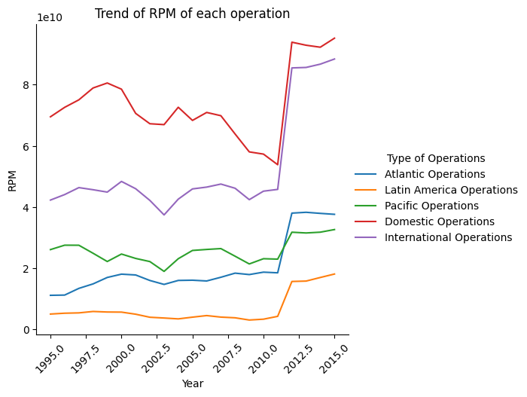
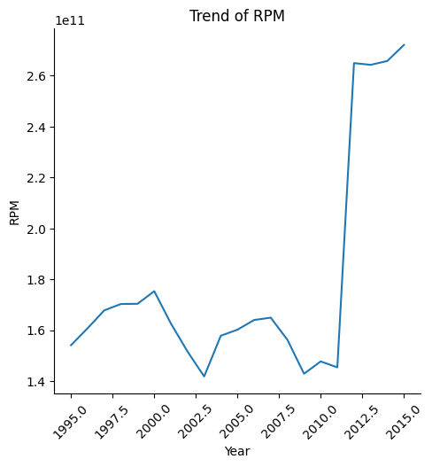
Results- Research Question 1
A revenue passenger mile (RPM) is a transportation industry metric that shows the number of miles traveled by paying passengers and is typically an airline traffic statistic.
By looking at the graph ‘trend of RPM of each operation’, the domestic operation has the highest average RPM, and the Latin America operation has the lowest average RPM. One similarity for all operations is that RPM increased dramatically in 2011.
By looking at the graph ‘Trend of RPM’, RPM is the lowest in 2003 and highest in 2015. The overall trend of RPM is increasing but not very stable with a dramatic increase in 2011.

Slide 11
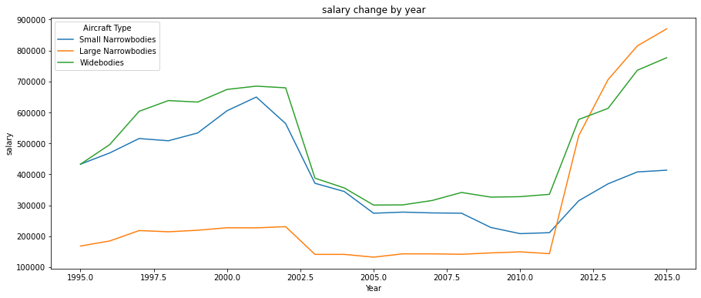
Results- Research Question 2
The result in this graph is very interesting and unexpected. We expect that larger the airplane is, the higher salary the pilots have. However, we saw that widebodies provide the highest salary before 2011, and large narrowbodies have the lowest salary. And the widebodies and large narrowbodies have a similar salary trend while the widebodies have an extremely low and different salary trend. We suspect that there was a sudden salary drop in 2001 with the huge shock due to the 911 attack, the airline industry lost millions of profits as people felt insecure traveling with planes, and the industry needed to put more budgets on security updates. We also notice that there was a great salary increase in 2011 for all types of aircraft pilots, which suggests that something changed around that time, either a policy that benefits the industry or the economic recovery from the financial crisis. What’s more, the positive trend in salary after 2011 also represents the rapid development of the economy in the US. And it’s surprising that after 2011, pilots who work in the large narrow bodies have higher salaries than the other two aircraft, while they have the lowest salary before 2011.
35%

Slide 12
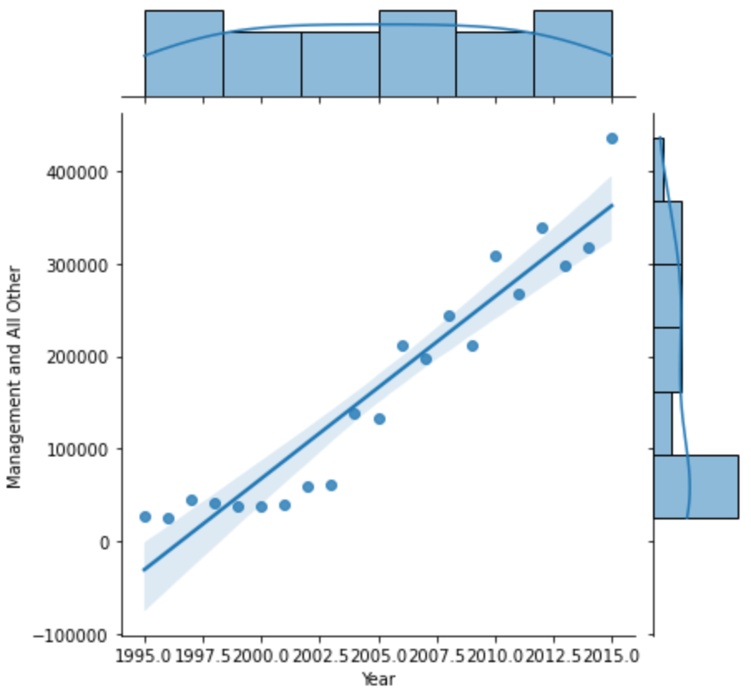
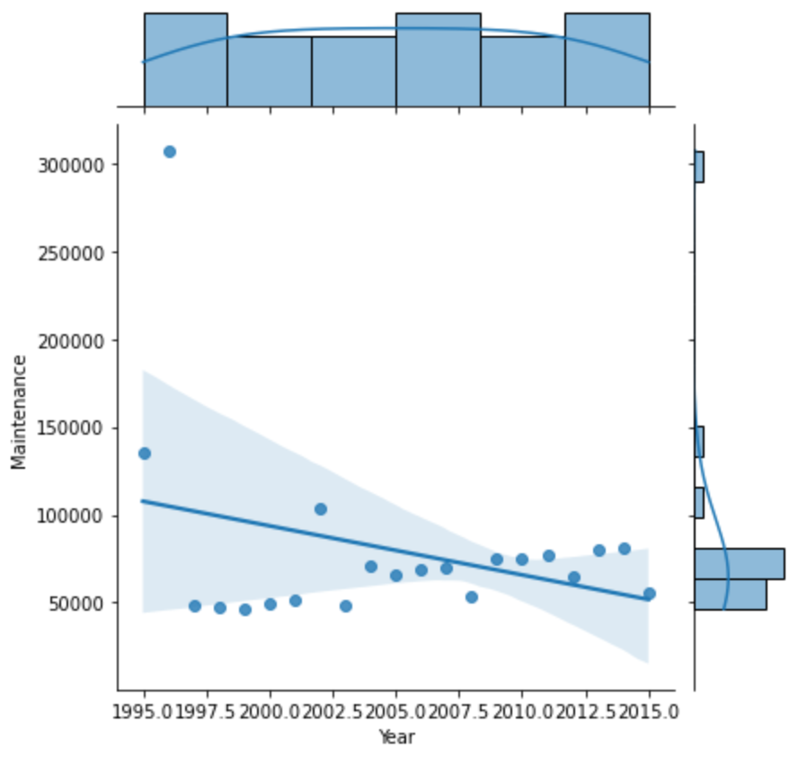
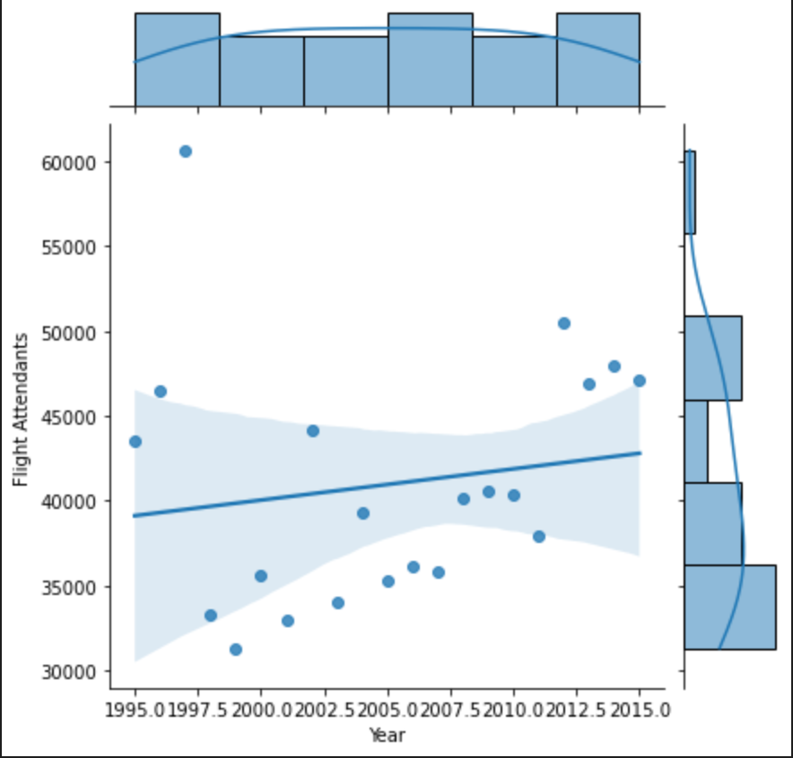
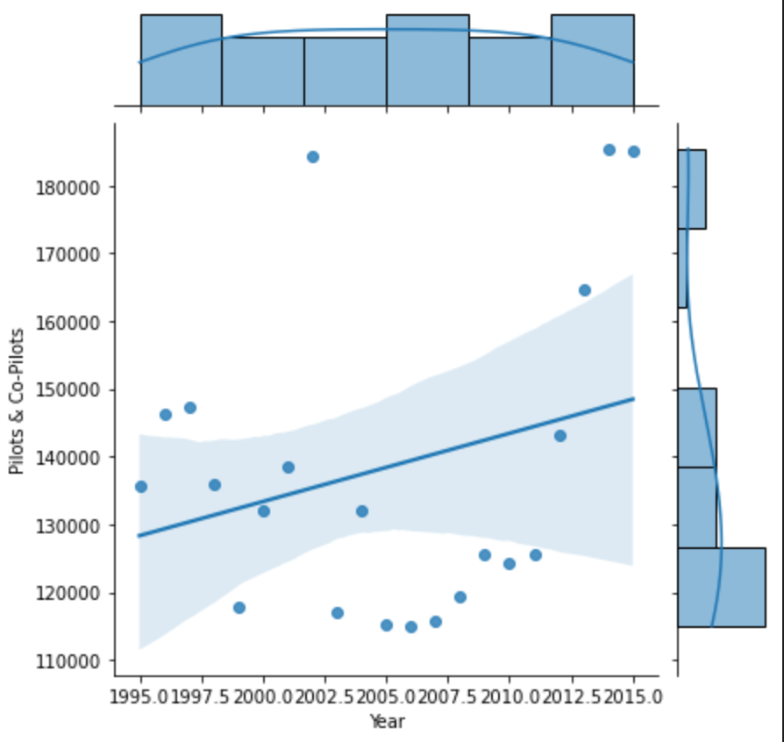
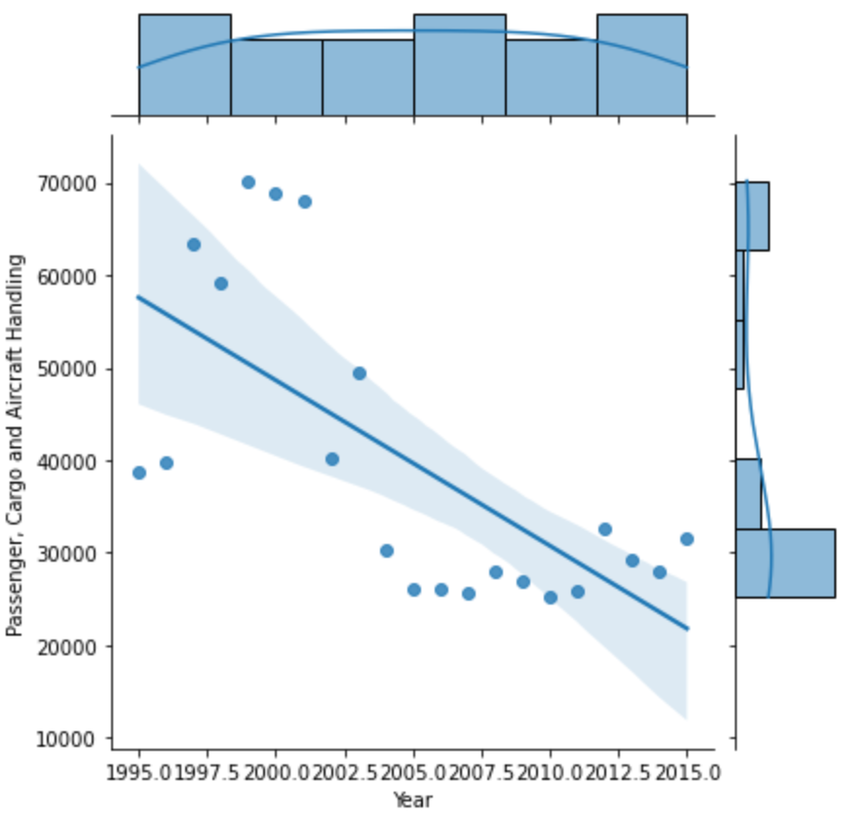
Results- Research Question 3
Our data visualizations show that the average salary for management positions increases solidly every year, and there is a strong association between those two from the graph.
As for pilots and co-pilots, their average salary increased at a steady rate from 1995 to 2015, and there was a positive correlation between pilots/co-pilots and their average salary.
Compared to pilots, flight attendants had a lower increase rate in average wage every year.
As time went on, employees for work for maintenance had a moderate decline in average salary.
Employees who take care of passenger, cargo, and aircraft handling face a tremendously decreasing average wage.

Slide 13
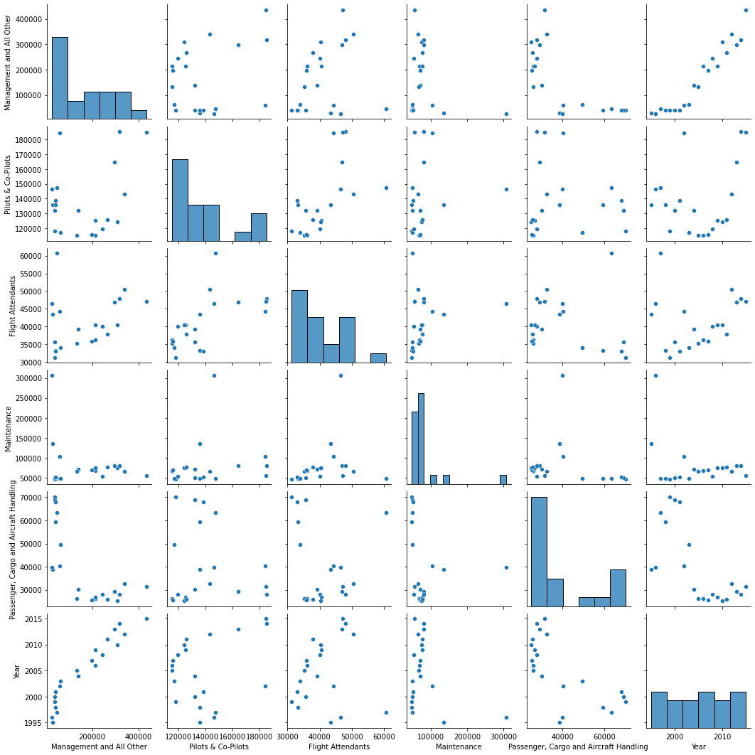
Results- Research Question 3
The overall plot demonstrates the highest average salary paid employees are working for management or other services at UA. Pilots and flight attendants have an increasing salary every year. The lowest average salary paid are employees who work handcrafting.

Slide 14
Takeaways of Our Analysis
Since the data we use is all from UA, we can not use the result to make inferences about the entire industry in United States or even other countries
The dataset has a vague definition of the position title “Management and All Others”. We don’t know exactly what other types of employees are part of this category

Slide 15
Future Work
As we mentioned above, there are some takeaways and limitation in our data analysis, therefore, we plan to look for more detailed datasets that cover more airline companies in the US, or even in the world.
Also, we noticed that there’s a sudden salary increase in the industry but we’re not sure about the reason behind this phenomenon. So we will conduct more research to figure it out.
In the future, we want to explore more various datasets in multiple areas. During this process, we’ve learned that data sorting and manipulation are two crucial steps in the project. We want to practice our critically thinking ability while we code, reflect, and improve!

